Slide 1
A Quest for Structure: Jointly Learning Graph Structure & Semi-Supervised Classification
Xuan Wu*, Lingxiao Zhao*, Leman Akoglu
*: Equal Contribution

Slide 2
Agenda
Problem Introduction:
Motivation for Learning Graph
Graph-based Semi-supervised Learning (SSL)
Existing Solution For Getting Graph for SSL
PG-Learn: Parallel Graph Learning for SSL
Gradient-based Graph Learning for SSL
Adaptive Parallel Search
Empirical Evaluation
Datasets & Baselines
Result
Notes:
Pass directly. Here is today’s agenda, now let’s go to see the motivation

Slide 3

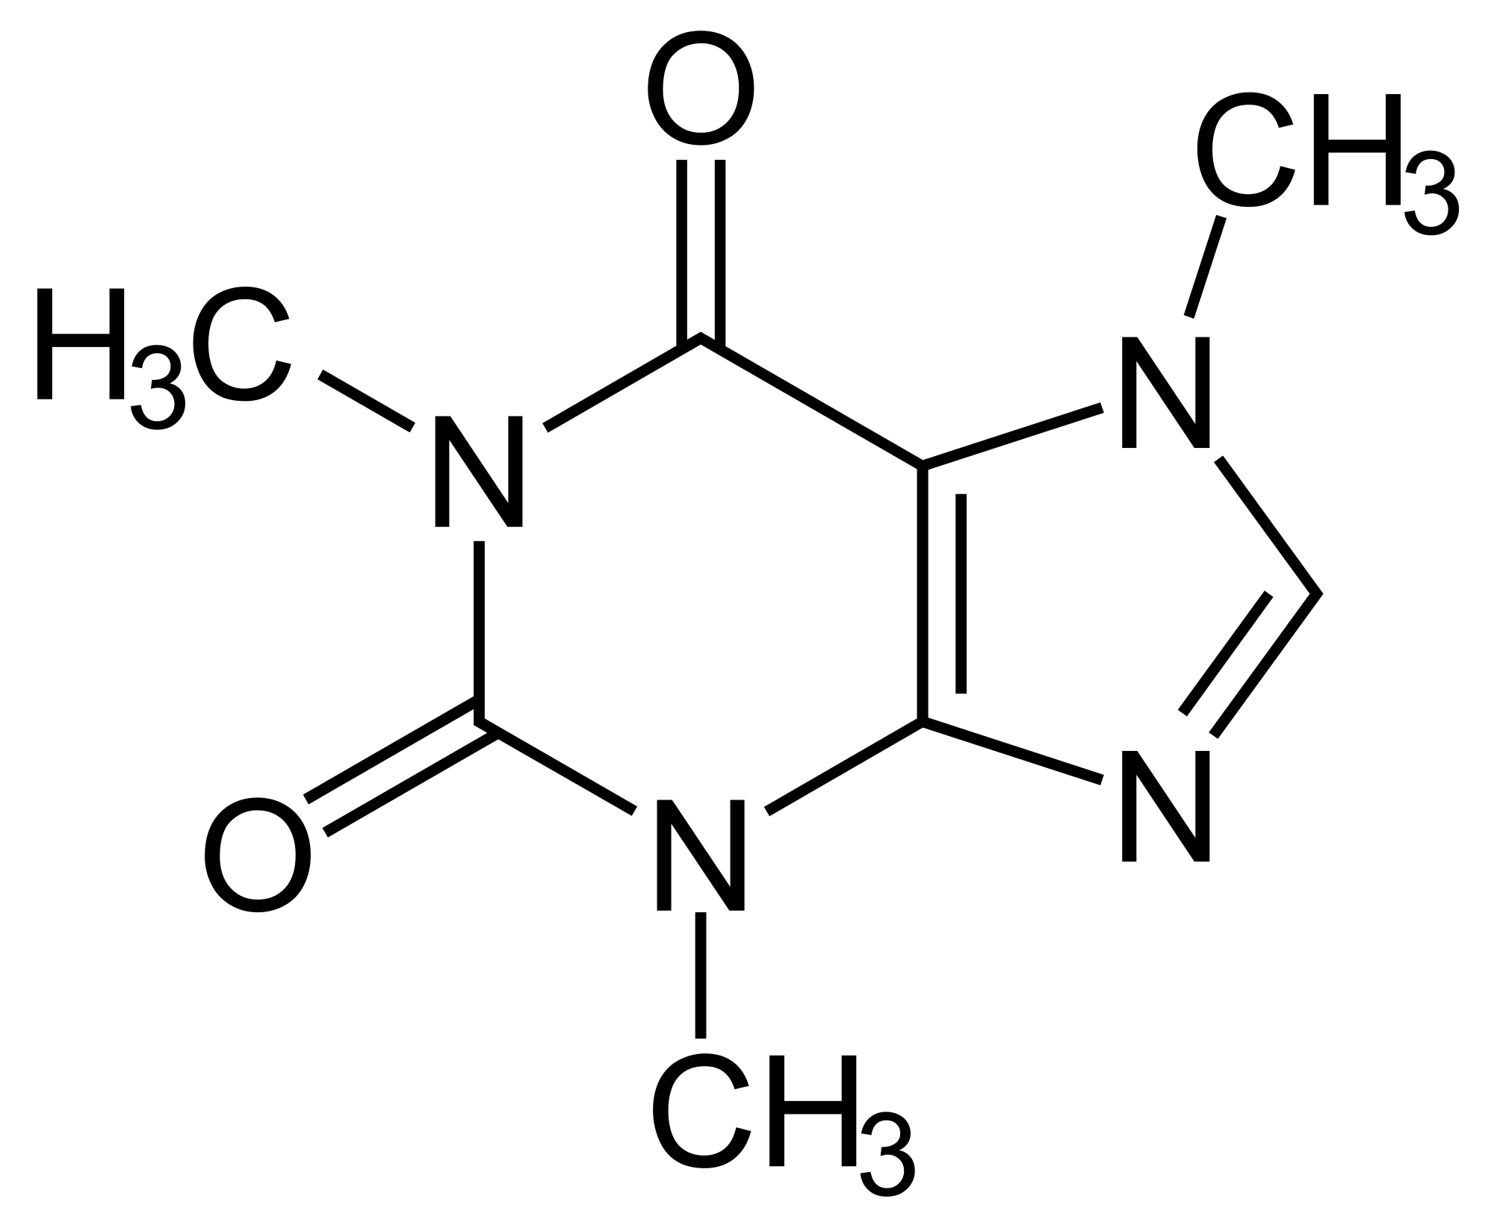

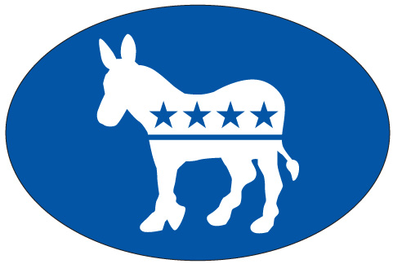
Motivation
Explicit, well defined graph
Limited and have noise
Usually just connections (No weights)
“Right” graph for any tasks? No!
Implicit graph
Not given the data
Need to be constructed based on domain knowledge
Needed for lots of algorithms
Question: how to learn a graph for a particular task,
from raw, high-dimensional, and noisy data?
Notes:
Structured data is everywhere, some of them are given the structure directly, like social network, chemical molecular, and knowledge graph. However, in lots of situation we only know that there is an implicit graph structure behind the data, but the structure is not given by the data. These implicit graphs are used by lots of algorithms, and we have to construct the graph based on our domain knowledge.
Questions --- And in this talk, we are going to answer this question for graph-based semi-supervised learning

Slide 4
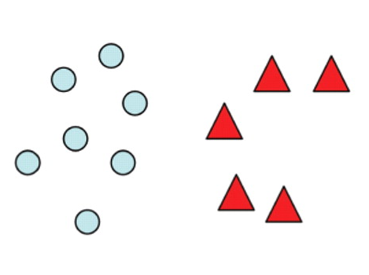
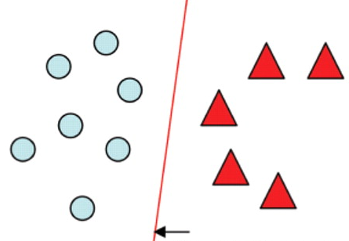
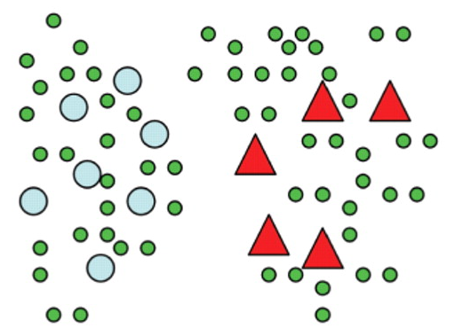
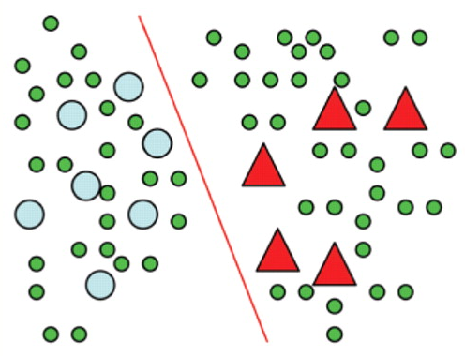
Background: SSL
Semi-supervised Learning
labeled data
supervised learning
labeled+unlabeled data
semi-supervised learning
Notes:
Now let’s briefly review some background.
Different from supervised learning which only use labeled data, semi-supervised learning aim to make full use of labeled and unlabeled data to learn a better classifier. The assumption that makes SSL work is that unlabeled data also contains information which is helpful for the learning. Like the distribution of unlabeled data.

Slide 5
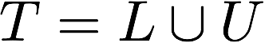
Background: Graph-based SSL
Given
set L of labeled nodes
set U of unlabeled nodes
a graph W of all nodes
Assign
Label Y or Class Probability F to unlabeled nodes
Solution
Closed-form
Iterative solution
Notes:
And graph-based SSL is a particular solution for SSL. It’s defined as following.
There are lots of variants of objective functions used for graph-based SSL and most of them are similar, we give one (LLGC) used in our paper.
The first part measures the supervised loss which is the difference between true label and predictions
The second part measures the weighted difference of output between nodes, where the weight is the graph edge weight.
So this term tells that if xi and xj is connected to each other and the edge weight is large, then the output F of xi and xj should also be similar.
The solution of the objective function has two forms: closed-form and iterative form.

Slide 6
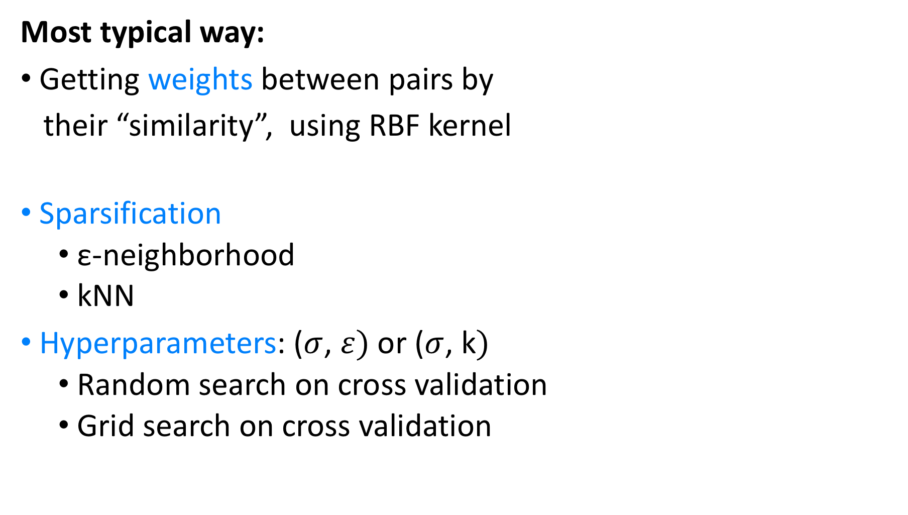
What you would do for W?
Most typical way:
Getting weights between pairs by
their “similarity”, using RBF kernel
Sparsification
ε-neighborhood
kNN
Hyperparameters: ($σ$, $ε)$or ($σ$, k$)$
Random search on cross validation
Grid search on cross validation
Notes:
If the graph is not given, we need to construct the graph first. So what you would do for W?
Her is the most typical way: you may want to define weight matrix => sparse weight matrix => choose hyperparameter.
This typical way works and used in real world. However, this may not be enough. This way seems too naïve.

Slide 7
W Matters!
“SSL algorithms are strongly affected by the graph sparsification parameter value and the choice of the adjacency graph construction and weighted matrix generation methods.”
Influence of Graph Construction on Semi-supervised Learning.
Celso Andre R. de Sousa, Solange O. Rezende, Gustavo E. A. P. A.
Batista. ECML/PKDD 2013.
Notes:
In 2000 and thirteen. Celso Andre did lots of experiment with graph construction for SSL and shows that :

Slide 8
Existing Solutions
Unsupervised
Locally Linear Embedding [Roweis&Soul Science 2000]
b-matching [Jebara+ ICML 2009]
Low-Rank Representation [Liu+ ICML 2010]
Anchor Graph Regularization [Wang+ TKDE 2016]
Supervised
Distance metric learning [Dhillon+ ACL 2010]
Multiple kernel learning [Li+ IJCAI 2016]
Constrained self-representation [Zhuang+, Image Proc. 2017]
…
No use of labels, not graph Learning
Not task-driven and/or scalable
Notes:
So people proposed different ways to get a better graph. And existing solutions can be divided into two category.
The first is unsupervised approach, such as…, but they …
The second is supervised way, such as … however some of them …

Slide 9
Agenda
Problem Introduction:
Motivation for Learning Graph
Graph-based Semi-supervised Learning (SSL)
Existing Solution For Getting Graph for SSL
PG-Learn: Parallel Graph Learning for SSL
Gradient-based Graph Learning for SSL
Adaptive Parallel Search
Empirical Evaluation
Datasets & Baselines
Result
Task-driven
Effective
Scalable
No hyperparameter to tune
Notes:
Comparing with existing solutions, we proposed a better algorithm, named PG-learn. And we claim
It’s task-driven…. And it doesn’t have hyperparameter to tune.

Slide 10
Parameterize W More Generally
Single bandwidth is not enough
Recall:
Different feature may prefer different bandwidth
Dimension-specific kernel bandwidth
Difficulty
Number of parameters: d can be more than thousands
random search / grid search won’t work
Notes:
Before go to problem formulation, let me tell about how we parameterize the W matrix, which makes it more general than the naïve solution. Notice that inside the most typical solution, all features share the same bandwidth. So the simple idea is to make each feature has their own bandwidth. In this way we come out to use dimension-specific kernel bandwidth for Gaussian Kernel. The parameter is the vector a whose component is the inverse of bandwidth.
The difficulty is that the number of feature can be thousands, in that sense rs and gs tend to work badly.

Slide 11
Problem Formulation
Given
Infer
: bandwidths per dimension
k : sparsity of kNN graph ( kNN is used to sparse W)
Labels for unlabeled points
W
Task
Jointly learning a graph W and solving SSL task,
so that W captures “right” structure needed by the task.
Notes:
Based on the way we parameterize W, now give out the formal formulation of the problem.

Slide 12
Link Quality of W with Task
Task-driven ✅
Define a loss g of W over F*
F* is ”better” means W has better quality
Using validation set
“better” means smaller ”difference” between F* and Y (true label)
over validation set.
A function of W
g(F*) over validation set measures the quality of W of the task
[the smaller the better]
Notes:
In order to make the weight learning be task-driven, we need to link the quality of W with task. So we define a loss function g of matrix W based on the output of SSL, which is F*. Notice that F* is the optimal solution of the objective function. And it has a close form solution, which is a function of W. Now we can see F* is better means W has better quality.
To define what means better for F*, we use validation set, which is a part belonging to (separated form) labeled set.
Now the function g(F*) ….
In this way, we claim that it’s task-driven.

Slide 13
Validation Loss g(F*)
Many ways to define the validation loss
As long as it can measure the different between F* and Y
e.g.
We choose a pairwise ranking-based loss
Validation set is quiet small
Pairwise makes full use of information
Node inside c
Node outside c
Prob of ranking v above v’,
based on output F
Notes:
Now we talk about the specific validation loss we used.
There are many ways to define the validation loss, one may want to use the pointwise difference, like cross entropy or the one shows here,( which is the direct difference between F and true label Y.)
We choose a pairwise ranking-based loss. The intuition is that validation set is quiet small and pairwise ranking-based loss can make full use of information inside the small set.
For each class c, the loss want to rank the nodes inside this class above the nodes outside the class pairwisely, according to the output of nodes F. You can see the inner sigmoid term measures the probability of ranking node inside class c over ranking node outside class c.

Slide 14
Minimizing g
Scalable ✅
Use gradient descent
F* has closed form, can get gradient w.r.t. W
Deriving gradient is omitted, please see our paper
Make full use of sparsity
Complexity
Computational complexity
k: #NNs, c: #classes, t: # power method iterations
linear in dimensionality, log-linear in sample size
Memory complexity
linear in both dimensionality & size
Notes:
For the optimization part, we use gradient descent to minimize the g function. I won’t talk about the detail of how we derive the gradient and also how we make full use of sparsity. If you are interested please look at our paper. We analyzed the computational complexity as well as memory complexity of our algorithm, and we claim that for complexity complexity, our algorithm is linear in dimensionality and log-linear in sample size. For memory complexity, it is linear in both dimensionality and sample size. So scalability is checked.

Slide 15

Summarize So Far
Notes:
Now we briefly summarize the gradient-based graph learning algorithm. We first initialize sparsification parameter k and initial point of graph parameter a. We iteratively compute output F at iteration t and its gradient w.r.t. graph parameter a, at step 5 we use the calculated gradient to update graph parameter a. This procedure is repeated until parameter a converged.

Slide 16
Adaptive Parallel Search
How about k and initial a?
Non-convex problem: Different initial point matters
Sparsity k always matters a lot
Solution
Try many effective configurations as much as possible in limited time
A simple & effective idea – Successive Halving
[Jamieson, AISTATS 2016]
pick a set of (hyperparameter) configurations
run for a fixed amount of time (i.e. iterations)
evaluate configurations (metric of interest)
keep the best half (terminate the worst half)
repeat 2. – 4. until one configuration remains
0th - order
Notes:
As we have seen before, we still have to decide how to initialize sparsity k and initial graph parameter a.
Initialization is nontrivial since this problem is non-convex, and sparsity parameter k always matters a lot.
A solution for this is to try many effective configurations as much as possible in limited time. And a simple but effective algorithm is successive halving. And here we briefly summarize the approach.

Slide 17
Adaptive Parallel Search
No hyperparameter to tune ✅
How about k and initial a?
Non-convex problem: Different initial point matters
Sparsity k always matters a lot
Solution
Try many effective configurations as much as possible in limited time.
A simple & effective idea – Successive Halving
Improve it by fully parallel
After halving, restart new configurations to reuse threads
And Not 0th – order anymore, our solution combined with 1st –order optimization
[Jamieson, AISTATS 2016]
Notes:
Instead of using original successive halving algorithm. We improved it by make it fully parallel. So after halving the bad configurations of at each round, we restart new configurations to reuse threads. In this way all resource are fully used at any time.
And notice that our combined algorithm is very different from original 0th order hyperparameter search algorithm, since we used gradient descent for each configuration.

Slide 18
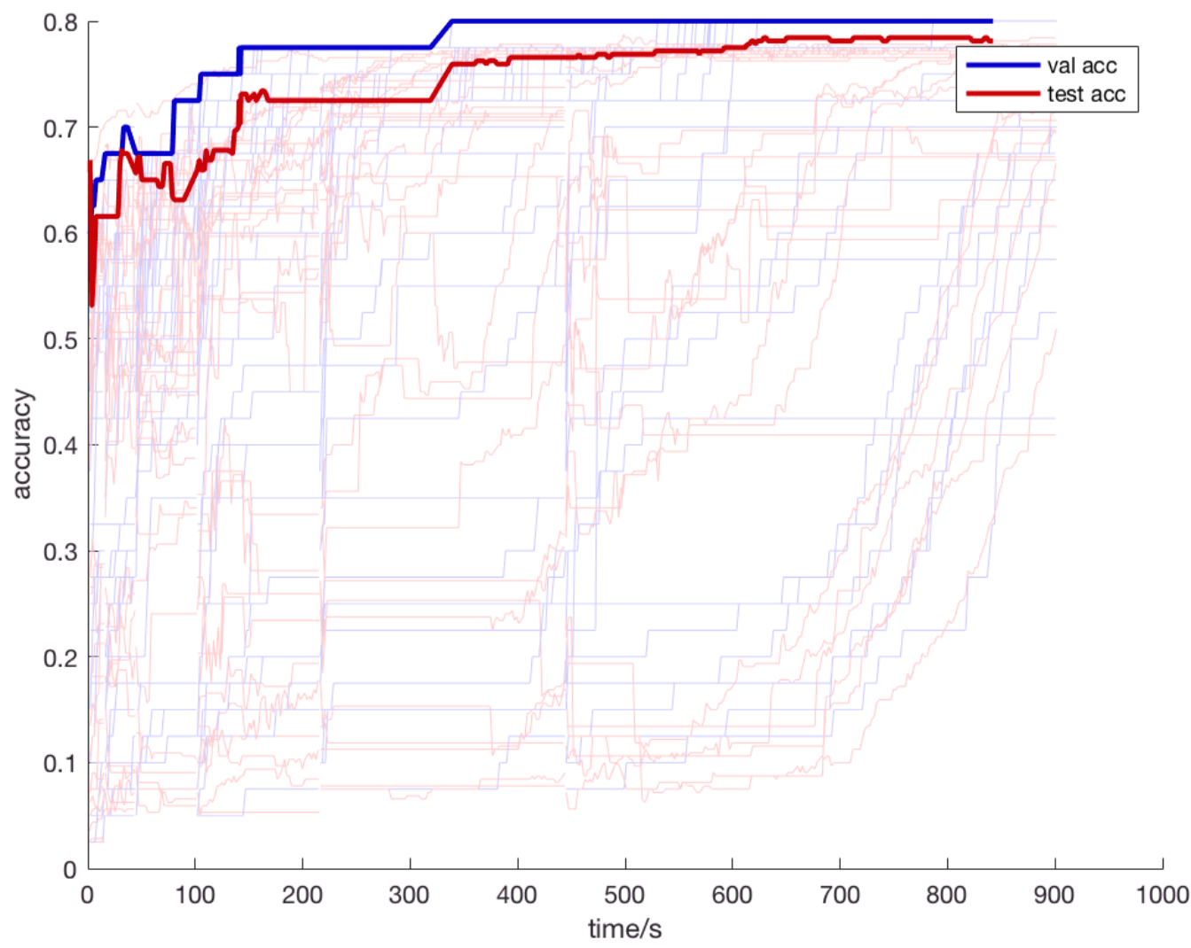
Test accuracy improves by time
Many poor configurations
Notes:
This is the real time performance of our gradient-based graph learning with adaptive parallel search.
The x axis is time, y axis is accuracy. And the blue line represents validation accuracy Red line represents test accuracy.
Thin lines represent each threads results, and the thick line is the combined results across all threads.
We can see that there are many poor configurations which were halved after each round.
And test accuracy improves by time.

Slide 19
Agenda
Problem Introduction:
Motivation for Learning Graph
Graph-based Semi-supervised Learning (SSL)
Existing Solution For Getting Graph for SSL
PG-Learn: Parallel Graph Learning for SSL
Gradient-based Graph Learning for SSL
Adaptive Parallel Search
Empirical Evaluation
Datasets & Baselines
Result
Task-driven ✅
Scalable ✅
No hyperparameter to tune ✅
Effective ❓
Notes:
We have seen that our algorithm is task driven, scalable and it doesn’t have hyperparameter to tune. Now let’s see empirical results to see the effectiveness of our algorithm.

Slide 20
Datasets
Notes:
Here are the datasets we used. All of them are muli-class dataset. Most of these datasets we used are image dataset, because the dimensionality is high. We can see the dimensionality varys from two hundred to one thousand.

Slide 21
Baselines
strawmen
gradient-based
self-representation
metric learning
Notes:
We have choose five baseline to compare with. The first two are grid search and random search, which are argued by others that should be combined every time. The second is one gradient-based algorithm, this is a revised version of MinEnt. The original one is proposed by zhu. And one state-of-art self—repsentation based algorithm AEW. The last one is IDML, which is a self-learning based algorithm.

Slide 22
Single-thread Results
Notes:
Now let’s see one single-thread experiment results. The experiment used 10% labeled data as training plus validation set. The result is average across 10 random experiments. And the little triangle symbol indicates the result of p-value test. We can see that pg-learn achieved best result in most of comparisons. The only exception is in USPS and MNIST dataset, MinEnt achieved similar performance with us.

Slide 23
Increasing labeling % , results averaged across all datasets
Single-thread Results
Notes:
Here is another single-thread result to investigate the influence of increasing the percentage of labeled dataset. And the result is averaged across all datasets. As we can see that PG-learn rank 1st for all datasets, with a very low p value. ( this means high confidence)

Slide 24
Parallel results with Noisy Features
Double the feature space by adding 100% new columns with Normal(0,1) noise
IDML failed to learn metric due to degeneracy
AEW authors’ implementation threw out-of-memory errors
24
Notes:
We also investigate on parallel setting. And to make the problem much harder, we double the feature space by adding 100% new columns with random noised value. For this experiment setting, the IDML algorithm always give bad performance due to the degeneracy problem, and AEW algorithm threw out-of-memory results. So we only compare our algorithm with other 3 baselines. As we can see on all datasets, PG-learn highly outperforms other baslines.

Slide 25
Parallel results with Noisy Features
investigating learned feature weights
Effective ✅
PG-Learn estimates lower weights for noisy columns
Notes:
To see whether PG-learn really learn meaningful parameter, we investigated the learned feature weights using box plot. As we can see, for usps, mnist, coil and umist dataset, PG-learn gives our a very low weights for noisy columns. This means PG-learn is doing the right job.

Slide 26
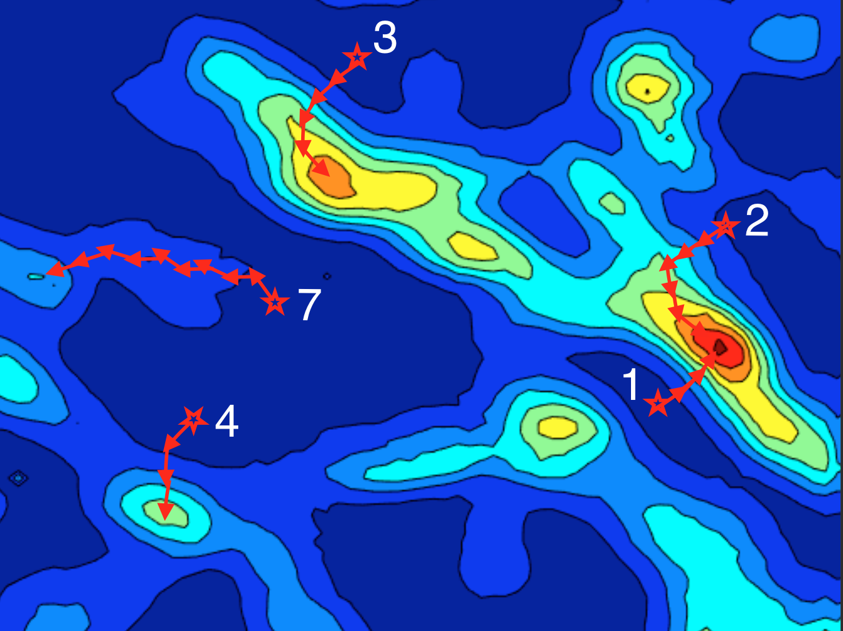
Code, Data, Slides
Task-driven ✅
Scalable ✅
No need to tune ✅
Effective ✅
PG-Learn
https://pg-learn.github.io
Thanks!
Conference attending is funded by travel grant from SIGIR
26

